Slide 1
Debunking the Spelling Myths
How Can I Help My Child Practice?

Slide 2
Why is there no list?
Current research shows students learn long-term spelling skills by word study
Cramming for a week on words usually leaves the words misspelled soon after the test is done
Pattern/Word Study allows students to adapt their learning to new and unfamiliar words
More capable of spelling words that they don’t know when they know the patterns

Slide 3
Where do I find the pattern?
Parent Homework Letter (teacher sends home, possibly)
OR
http://csdela.weebly.com/weekly-study-skills-hw-sheets.html

Slide 4
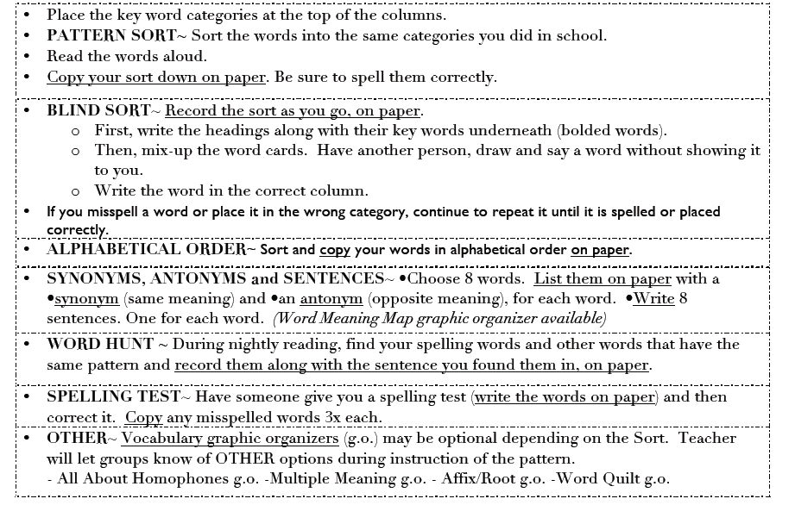
Nightly Activities

Slide 5
Smack Down!

Slide 6
Spelling City
www.spellingcity.com
Enter your own list of words that follows the pattern
Create a variety of activities for your child to do ☺

Slide 7
More Games and Activities
http://secondstorywindow.typepad.com/home/words-their-way/
http://www.fcrr.org/curriculum/SCAindex.shtm
Phonics
Fog Window App
Students breathe into mic and “write” on the screen just like a foggy window

Slide 8
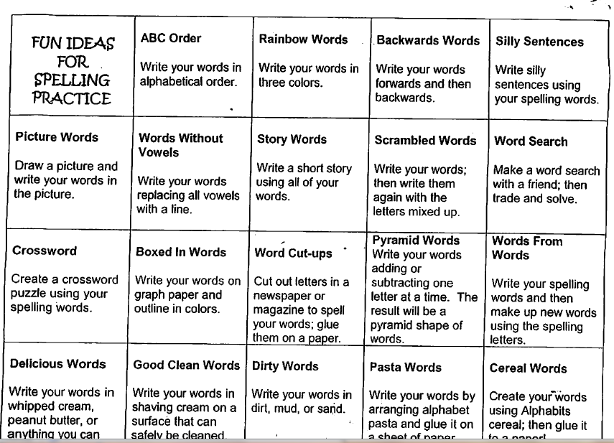
Fun Spelling Ideas
Playdough/clay to create words
Letter beads
And more…

Slide 9
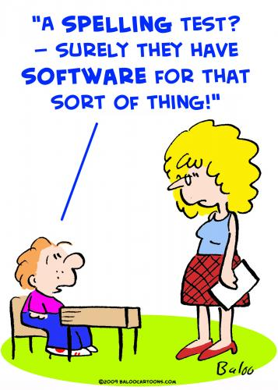
Thank you for coming!

