Slide 1
Feedback
Focusing on the Positives

Slide 2
Mindset: Fixed vs. Growth
Read p. 7-9—start/end at *
Quick Write: Which mindset do you think you have? What makes you think that?
Mindset Quiz: Which one are you right now?
P. 12-14—Take the Quiz

Slide 3
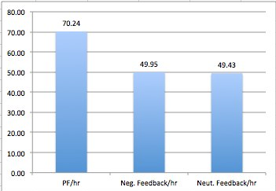
Our School’s Goal
To increase our positive feedback ratio by converting our neutral feedback to positive feedback
Positive Feedback
Corrective Feedback
Neutral Feedback

Slide 4
Definition:
Definition: The purpose of _____ is to let someone know whether or not a task was performed ______, and how it might be improved. Feedback clarifies the difference between the _____ and ______ levels of performance and illuminates what steps could be taken to meet the expectations. ______ is most effective when it is clear, ______, compatible with prior knowledge, ______, and non-threatening.
feedback
correctly
current
expected
Feedback
purposeful
immediate
Word Bank: immediate, feedback, correctly, expected, current, purposeful
Notes:
Handout cloze paragraph. Give them time to fill in using the word bank. Then read and have them choral respond with the answers.

Slide 5
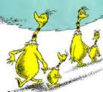
Rationale:
Educational research indicates that feedback is one of the most powerful drivers of student achievement. In Hattie’s book Visible Learning, a synthesis of meta-analyses, the overall effect size of feedback is very high (ES = .75):

Slide 6
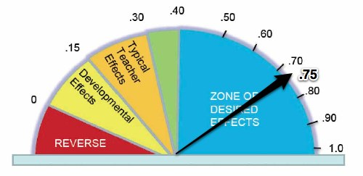
Effect Size = .75

Slide 7
Word Bank:
correction, ratio, negative, positive, behaviors, on-task behavior, academic, problem behaviors, underused, research, reprimands, praise, behavioral
Notes:
Need to copy text on next slide with blanks for red words and allow them time to fill in the blanks.

Slide 8
Rationale Continued
The use of positive feedback, including general and specific praise for student behaviors, and the role of negative feedback in the form of reprimands and correction has been a well-investigated phenomenon. Positive academic and behavioral feedback, or teacher praise has been statistically correlated with student on-task behavior and has strong empirical support for both increasing academic and behavioral performance and decreasing problem behaviors. However, it is often reported as an underused teaching tool despite the supporting research. With regard to reprimands and correction, there is a continued assertion that teachers maintain a ratio of praise to correction at 3:1 or 4:1.
Hattie, 2009; Apter, Arnold & Stinson, 2010; Gable, Hester, Rock & Hughes, 2009; Shores, et al, 1993; Sutherland, Wehby & Yoder, 2002; Stichter, Lewis & Wittaker, 2009
Notes:
Need to copy text on next slide with blanks for red words and allow them time to fill in the blanks.

Slide 9
Characteristics of Quality Feedback
Feedback is most effective when it is:
Clear
Purposeful
Compatible with prior knowledge
Immediate and Timely
Non-threatening
Notes:
Piper

Slide 10
Back to Mindset
What kind of praise is best for supporting intrinsic motivation in students?
Read. P.173-180 and 197
Use the four square notetaking template to perform a close reading of the text
In your table groups, discuss some ways to give positive feedback that helps to develop a growth mindset.
Notes:
Four Square Notetaking Template

Slide 11
At Bat: “Teach them the basics of how to hit, and then get them as many at bats as you can.” Teach like a champion 2010
Teach the basics
Guide the skill with feedback
Build automaticity. . . Let them do it over and over Commit to muscle memory
--The best predictor of success is previous success. The best predictor of failure, is previous failure. Give them opportunities to be successful.

Slide 12
Examples of Feedback
Use the table, labeled Positive, Neutral and Corrective
Tally feedback
Clip 20
Clip 23
Positive | Neutral | Corrective
III | I | II
Notes:
Teach like a champion clips
Find tally tables in packet

Slide 13
Think about a skill you developed
Quick Write: Describe an instance in your learning where feedback helped you in your development
Share how feedback helped you in the development of that skill.
Notes:
Record quick write in packet
Share: Find someone who has similar shoes as you

