Slide 1
Four Square Writing
Grades K-2
November 16, 2012

Slide 2
Where is the writing in Reading Street?
Writing on Demand Quick write Concept Map—Written Response Build Writing Fluency Distributed Practice | Daily Mini Lessons Variety of products/genres Key Features Modeled examples (TE and SE) Quick write for fluency
Research and Inquiry Connects to Question of the Week Has a product every week (balance) | Customized Writing Big projects Connect to S.S./Science Be selective
Everywhere!

Slide 3
What does research say?
Recommendation | Strong Evidence | Moderate Evidence | Minimal Evidence
1. Provide daily time for students to write.
2. Teach students to use the writing process for a variety of purposes. 2a. Teach students the writing process. 2b. Teach students to write for a variety of purpose.
3. Teach students to become fluency with handwriting, spelling, sentence construction, typing and word processing.
4. Create an engaged community of writers.

Slide 4
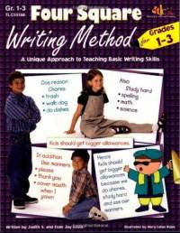
What is Four Square Writing?
Four-square writing is a method of teaching basic writing skills that is applicable across grade levels and curriculum areas. It can be applied for the narrative, descriptive, expository, and persuasive forms of writing.

Slide 5
What is Four Square Writing? Cont…
Prewriting and organizational skills are taught through the use of a graphic organizer.
This visual and kinesthetic aid is employed to focus writing, to provide details, and to enhance word choice.
The visual organizers help students to conceptualize, understand, and structure a piece of written discourse successfully.

Slide 6
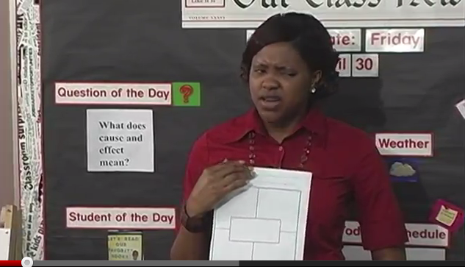
Using it in the Primary Grades

Slide 7
Steps to Using Four Square
Step 1: Start with Box 1—Topic Sentence
Step 2: Brainstorm three different supporting ideas for your topic and put those in box 2-4
Step 3: Write a concluding sentence—could be a summary, feeling statement, etc.
Step 4: Get some writing paper and turn your four square into a paragraph.
Step 5: Taking your paragraph through the writing process. (with selected pieces)

Slide 8
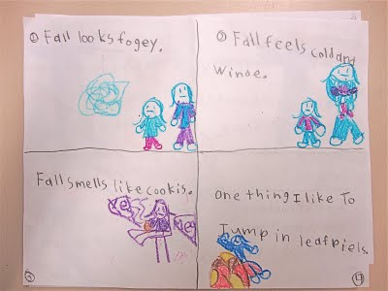

Slide 9
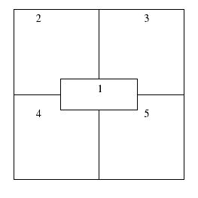
Typical Starting Point 1st-2nd
Supporting Idea
Supporting Idea
Topic Sentence
Supporting Idea
Concluding Sentence

Slide 11
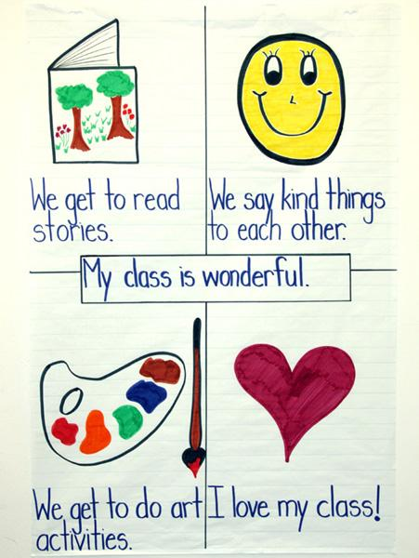

Slide 12
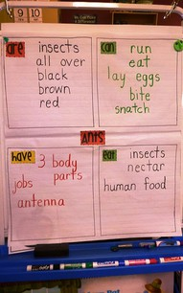

Slide 13
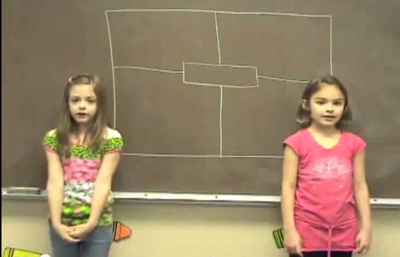
Four Square in First Grade
http://www.youtube.com/watch?v=gdhv-VWoqD8
http://www.youtube.com/watch?v=sg0tixtWIgo&feature=endscreen&NR=1

Slide 14
Now let’s try it!
Fold your paper
Box 1: Topic Sentence: There are some great reasons to use the four square in writing instruction.
Box 2-4: Write 3 reasons as to why it is great to use
Box 5: Write a feeling sentence
Viola!

Slide 15
Your Task
Alone, in partners, or as grade level
Look at the next writing piece (mini-lesson product, research and inquiry, or customized writing section)
Outline how you would use the four square to plan with students writing their paragraph

Slide 16
Example: 1st Grade Research and Inquiry: Unit 2.4
One great thing about __________ is __________ ______________________. | Another reason, I like _______ is _____________________.
The best thing about _______ is _____________________. | I like ______ because ______________________.
My favorite animal is ____________.

Slide 17
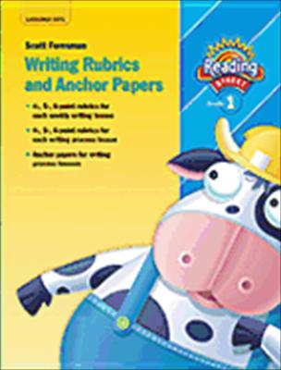
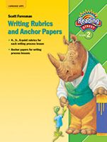
Writing Rubrics and Anchor Papers

Slide 18
Database of Award Winning Children’s Literature—Example Texts

