Slide 1
Lexia Reading
An online tool to support your child’s reading development
Grades K-3

Slide 2
Who Am I?
Jennifer Throndsen
Oak Hollow’s Achievement Coach
Evidence Based Learning Department
Jennifer.throndsen@canyonsdistrict.org
Location: Room next to the library—across from Mr. Levitre

Slide 3
What is Lexia?
An adaptive technology
Individualized instruction
Tool for at-risk, on-level and advance level learners
Builds the foundational skills of reading
Let’s take a tour…

Slide 4
Product Tour Video

Slide 5
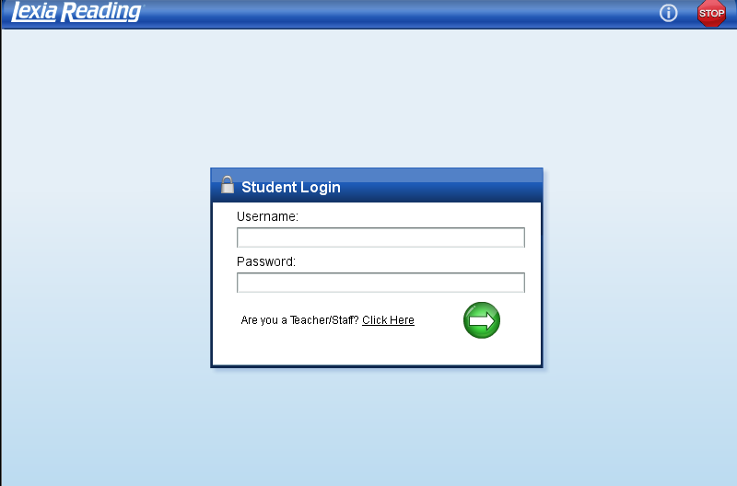
Login Screen

Slide 6
Student View

Slide 7
What it is like
Notes:
Take them into the program and show them how it works…

Slide 8
Benefits of Lexia
Increase student confidence
Build literacy skills
Phonological Awareness
Phonics
Fluency
Comprehension
Engages students in a game-like environment with instant feedback and scaffolding
Reports of progress and usage can be sent to you via email
Certificates of Level completion will be sent home to congratulate students on their progress.

Slide 9
Coming Soon!
If you are interested in trying Lexia at home with your child, please fill out the Lexia Reading Request Form and submit to me
Student’s Name
Grade Level
Classroom Teacher
Parent’s Name
Parent’s Email
On the iPad—Late 2012

