Slide 1
Small Group Instruction
Ideas for what your students could be doing while you pull small groups

Slide 2
Chapter 1 What is a Literacy Work Station?
Dillard’s definition: An area within the classroom where students work alone or interact with others, using instructional materials to explore and expand literacy. It is a place where a variety of activities reinforce, or extend learning, often without assistance of the teacher. It is a time for children to practice reading, writing, listening and working with letters and words.

Slide 3
Points to Ponder
Literacy Work Stations:
Are not something extra. They are not “fillers of time.”
They should replace worksheets
They provide choices that are relevant, personal and engaging.
Should be set up for student success

Slide 4
Activities
All activities should be previously learned
Use new words for word sort
Extend word activities into writing activities
Academically engaging
As much fun as cutting out boots and pasting on glitter might be to the students, it is not instructionally relevant.

Slide 5
Non-Negotiables for LWS
Focus on practice and purposes
Link to your teaching
Slow down to speed up…..start slowly & build
Balance process & product
Less is more…keep materials to a minimum
Use novelty…try one new thing at a time
Simplify – if it takes longer for you to make it than it does for the children to use it instructionally…..don’t do it!!

Slide 6
Establishing Routines
Rules for Stations
Moving to stations
Asking for help
Being accountable
Activities
Previously learned
Academically engaging
Notes:
Teach all students the rules and expectations for center time.
Develop a system for moving to centers. Students need to know where to look in order to know where they are required to go for each rotation. A planning board indicates which centers students go to each day. Students need to know when it is time to clean up and switch to a different station. Some examples of signals are a timer, wind chime, bell, clap of hands, or a flash of lights.
Establish a form of communication for asking for help. Students needs to know how to get the teacher’s attention while he/she is with a small group of students. Students also need to know what to do if something goes wrong at the center. One common example is to use the, “Ask three before me,” rule.
Students need to be held accountable for the work that is done at each center. Some form of an Exit Slip is suitable where students record the name of the center they went to and what they did at that center. These slips can be turned in for some form of a grade.
2. The activities that students are expected to complete at workstations or their desks need to be reviews of previously learned skills. By using activities from current classroom learning, you are providing students with the opportunity to fully grasp concepts and solidify understanding, as well as practice critical reading and writing skills. Incorporating review activities into this type of arrangement, you minimize the need for teacher assistance as well as help the students apply their knowledge to various related tasks.

Slide 7
Peer Pairing Scheme
Rank-order your students in terms of reading skill.
Split them in half (more skilled half and less skilled half).
Student 1
Student 2
Student 3
Student 4
Student 5
Student 6
Student 7
Student 8
Student 9
Student 10
Student 11
Student 12
Student 13
Student 14
Student 15
Student 16
Student 17
Student 18
Student 19
Student 20
Student 21
Student 21
Student 23
Student 24
Notes:
Now, we will talk about how to form pairs. The scheme we are discussing
with you has been used successfully in thousands of classrooms. The steps are located in your Fiver Star Reading Recipe Book on page __. Please turn to that now.
Allow @ 15 seconds.
The first step is to rank order all of your students in terms of reading skill.
You should have some assessment data on which to base your ranking, even if you do not, rank them according to your best judgment. It is not important that you be exact. Just be close. Remember you want students of adjacent reading abilities to be paired.
(Fuchs, Mathes & Fuchs, 1992; Greenwood et al, 1986; Mathes, Torgesen, Allen & Allor, 2001

Slide 8
Class Library Station

Slide 9
What Teachers Must Do It will make your life easier.
How to Introduce the Classroom Library
Tour your classroom literacy areas. Explain your classroom organization.
Go over literacy stations, expectations, responsibilities, and consequences.
* Literacy stations are a team effort.
Be a Model
Go over how to choose a book. Model and verbalize the steps you follow. Older students can use “five-finger” test.
Have students explain to each other how they chose a book. This will reinforce that they should “think” before selecting a book.

Slide 10
What the Children Do
Reading information from “an author study poster”
Using a “How to Choose a Book” chart to choose books
Reading familiar books
Reading independent-level texts
Looking at pictures in a book and telling the story to a partner
Author’s Box—favorite author—variety of books to look at
Sharing favorite parts of books with a partner
Reading books and magazines to stuffed animals
Writing response to a book
Write a note to a friend about a classroom library book
Write personal connections or questions on sticky note
Writing a book review of a classroom library book

Slide 11
Writing a Book Review
Show students book reviews on sites like Amazon or Barnes and Noble
Model writing a book review from a shared reading experience
Students can use the Sample Online Book Review sheet
Provides evidence that they have read
Integrates reading and writing
Opportunity for reflection
Create class book

Slide 12
Poetry Work Station

Slide 13
What the Children Do
Reading a poem
Illustrating a poem
Filling in the blanks
Building a poem
Changing a poem
Copying a poem
Listening to a poem
Writing a poem
Comparing two poems
Memorizing and performing a poem

Slide 14
Materials
Tub of favorite poetry books
Jump rope rhymes and tongue twisters
Songbooks
Paper, pencils, crayons
Magazine pictures
Copies of student written poems
Poems copied onto large chart paper

Slide 15
Introduce the Poetry Work Station by modeling:
How to read a poem fluently
How to read with good expression
How to find rhyming words
How to make connections
How to create visual images
How to write a poem
How to buddy read a poem

Slide 16
Ways to keep the Station Going Throughout the Year
Change the poems as often as needed
Add new poetry books
Add a new poet study tub
Add a new kind of paper for copying poems
Provide shape paper for copying poems
Add a new medium for illustrating poems

Slide 17
Drama Work Station

Slide 18
Drama Work Station Highlights and Overview
The drama work station is the place to “improve reading comprehension and fluency, as well as to encourage creative expression”. Children enthusiastically visit this station to read plays and retell stories. It is a “space where oral language related to books can flourish. The more the children read, the better they get at reading.” Activities designed to engage and promote student learning at this station include:
Retelling a familiar book.
Using puppets, props, and dramatic pieces to retell a familiar book.
Reading a familiar play, reader’s theater script, or a student authored play.
Writing ads for the play students will enact and/or audio taping a performance.
Use the Reader’s Theater Anthology from Reading Street for scripts

Slide 19
Pocket Chart Work Station

Slide 20
What to Do
Write up Sing with Me songs on sentence strips, cut into words, and students put it together like a puzzle
Other songs
Nursery Rhymes
Familiar Poems
Anything that can be sorted, sequenced or matched
Could be as simple as putting in letter cards and have them do “making words”—see example

Slide 21
Big Book Work Station

Slide 22
Big Books
Give students access to the big book from the Reading Street Materials
Students can:
Point to words (one-to-one matching)
Practice reading the pages with a pointer
Talk about favorite parts of big book story
Write a book review
Use wiki sticks to highlight high frequency words, word families or other phonics components you have been focusing on (inflectional endings, vowel teams, etc.)
Substitute words in story—use a post-it and cover the words with a synonym
Use highlighter tape to highlight words you can read and practice reading those words
Write connections on sticky notes.

Slide 23
Writing Work Station

Slide 24
Writing Work Station
Students sit near the word wall.
Students have access to all the tools they need nearby: pencils, crayons, paper, etc.
Use a help board to generate ideas

Slide 25
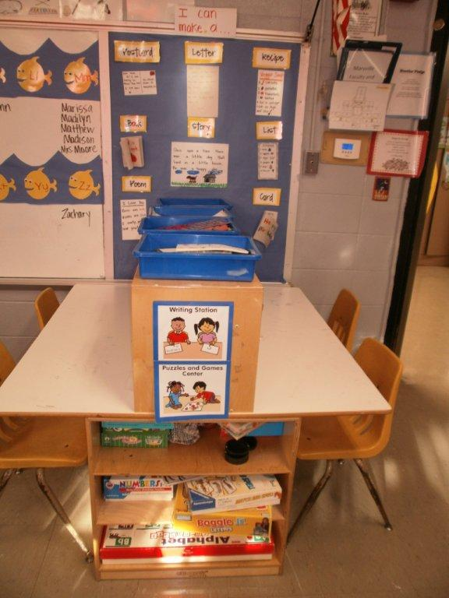
Help Board

Slide 26
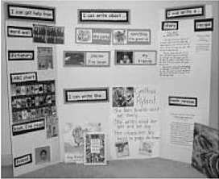
Another Help Board

Slide 27
Listening Center

Slide 28
Listening Center
Listen to the weekly selection on iPad/Computer/CD
Cheap headphones—at dollar stores
Books on CD—book orders, library system
Record the title of the book, author and what they liked about the story upon finishing
Non-writers—draw a picture of your favorite part of the story
Reading Response Sheet (handout)

Slide 29
Word Work
Letter Sorts (stick, circle, dot, hump, tail, slant)
Word Sorts—Sort word wall words by
One letter (or two, or three, or four)
One syllable (or two, or three, or four)
Short a (short e, etc.)
Long a (long e, long i, etc.)
Silent e
Nouns (verbs, adjectives, etc.)
Animals (colors, people, numbers)
Letter formation letters on sandpaper
Build words from word wall using magnetic letters or letter tiles
Play dough/clay to make letters or words
Letter stamps and stamp pads (names, word wall words, etc.)

Slide 30
Extending Word Work
1st grade chunk lists
Sort the words—word cards
Make the words with magnetic letters or tiles or pasta
Trace the word
Write the word

Slide 31
Buddy Reading
Procedure:
A pair of students sit beside each other
Each holds a copy of the same book
Children take turns reading in a variety of ways (choral, echo, whisper, one page and alternate, read the whole book and then switch)
Keep it fresh…
Add new books over time
Remove books that children have grown tired of.
Add two pairs of matching glass

Slide 32
Using the Room

Slide 33
Word Hunters
Look around the room for words with the previous week’s/current week’s phonics and /or spelling focus
Use fancy pointers or where fancy glasses
Walk around with clipboards and record the words they find
Sort the words into categories or groups
Rainbow color the words
Draw a sketches for the words

Slide 34
Hangman with Word Wall
Students play hangman using word wall words
____ _____ _____ _____

Slide 35
Reflections on Effective Differentiated Instruction
Currently Do:
New Techniques:
Pledge: I commit to implementing the following 2 new techniques in my classroom:_________________________________________________________________________________________________________________________________________________
Signature_____________________
Notes:
On the next page of your participant notes, you will find a Reflections page. Please take that out.
Allow 15 seconds.
Point to each column as you discuss it.
In the "Currently Do" column, write down each technique that we've discussed or that you saw in the film that you already use in your classroom.
Allow 2 minutes.
Now, in the "New Techniques" row, write down techniques that you've learned today that you believe you could implement.
Allow 2 minutes.
Now, place a check mark next to at least two techniques that you will commit to implementing in your classroom.
Allow 1 minute.
I want you to fill out the pledge at the bottom. This pledge says you
will commit to implementing the two techniques you checked when
you get back to your classroom. This pledge is both to yourself and to your students.
Allow 2 minutes.

Slide 36
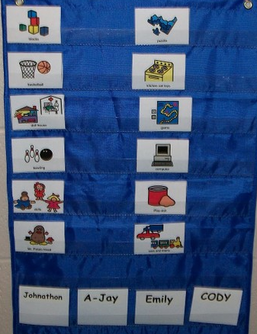
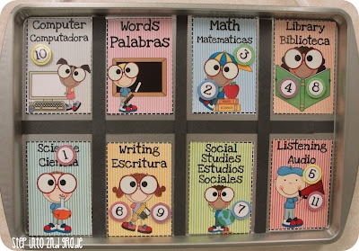
Management Boards

Slide 37
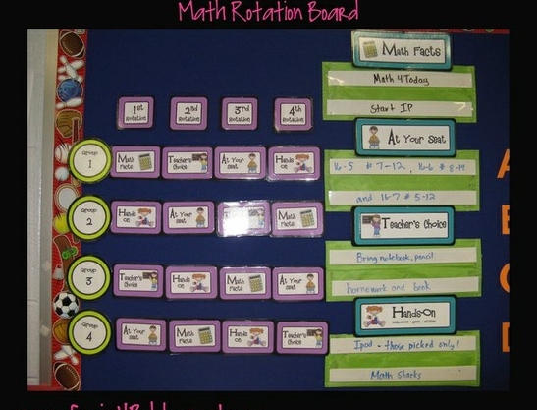
Management Boards

Slide 38
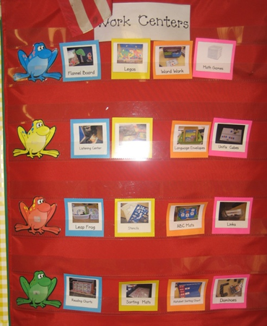
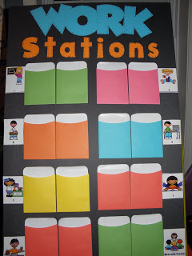
Management Boards

Slide 39
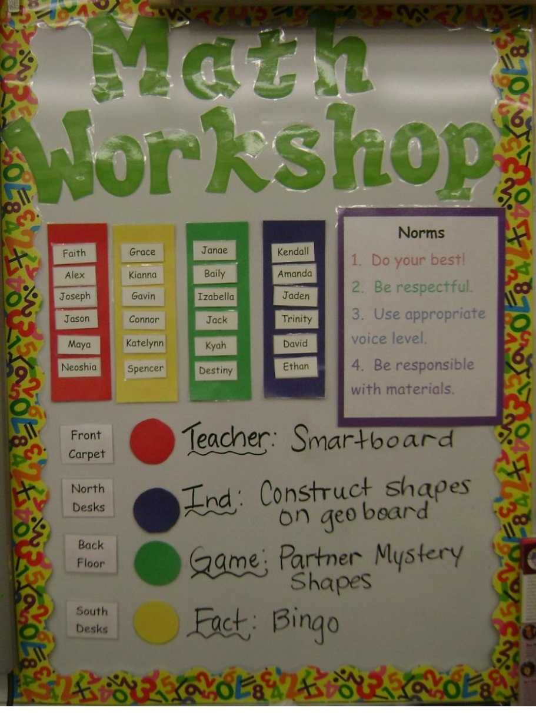
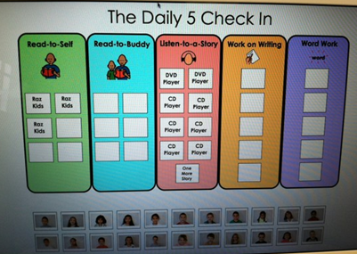
Management Boards

