Slide 1
Supporting Your Student as a Reader
What can I do at home to help my child?

Slide 2
READ, READ, READ
Read to your child
Let them read to you
10-20 minutes depending on the age of your child

Slide 3
If they are reading to you…
Books should be relatively easy
Open the book—read the first page (or pages if a beginning reader)
If your child struggles on more than 5 words on the page it is too difficult
Good rule of thumb—3 words is just right

Slide 4
Resources for Finding Just Right Books
Salt Lake County Library System
http://www.slcolibrary.org/kidzone/kzrc/rcBooklists.htm
Lexile Framework
http://www.lexile.com/fab
Story Line
http://www.storylineonline.net
Reading Rockets
http://www.readingrockets.org/audience/parents/
Selecting Books for Your Child
Reading Tips

Slide 5
Connecting School to Home
Pearson Successnet
www.pearsonsuccessnet.com
Reading and Math Programs at Oak Hollow
View Test Scores
Print remediation/enrichment worksheets
Do practice activities related to the current week of study
Let me show you how…

Slide 7
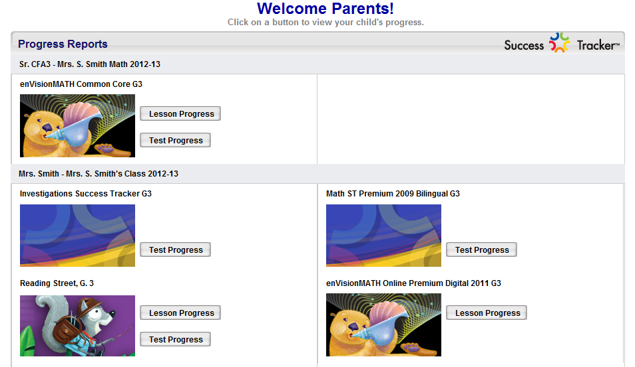
Click a button to see their progress

Slide 8
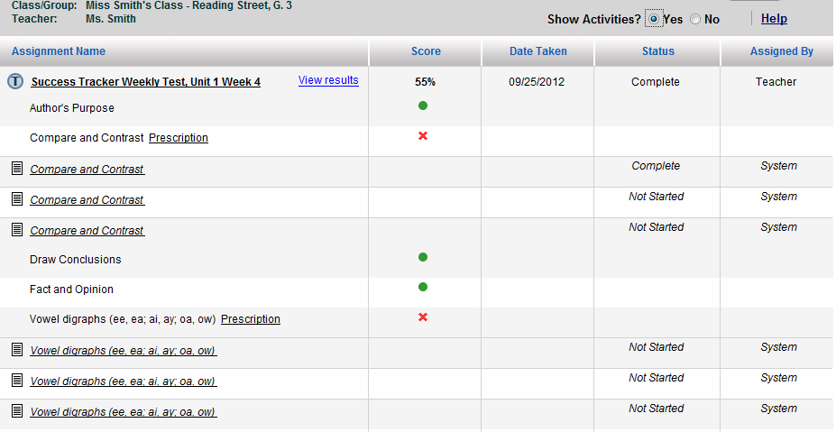

Slide 9
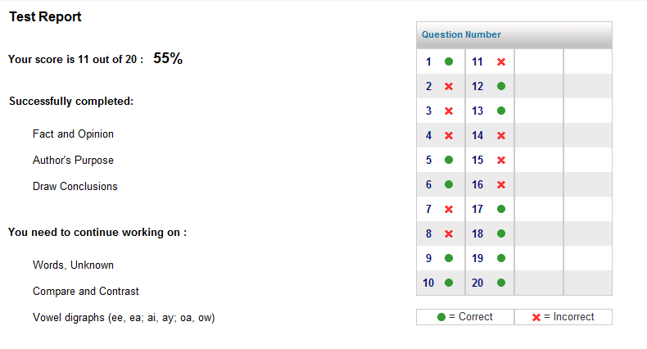
Test Report

Slide 10
Things you can do at home…

Slide 11
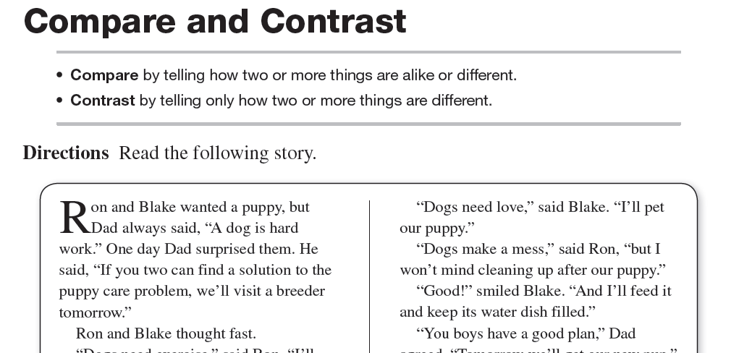
Worksheets for Additional Practice

Slide 12
Thank you for coming!!

