Slide 1
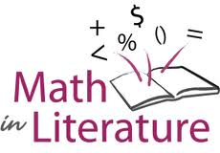
Using Math Literature to Meet the Demands of the Core Grades 1-4
Jennifer Throndsen
Evidence-Based Learning
Canyons School District

Slide 2
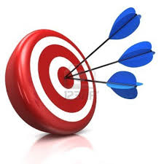
Objectives
Address the Standards for Mathematical Practice
Meet the expectations of the Core
Create context for mathematical reasoning and problem solving
Enjoy great literature! ☺

Slide 3
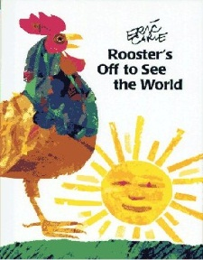
Rooster’s Off to See the World
Core Standard Connections:
1.OA.A.1—Addition/Subtraction
1.OA.A.2--Multiple Addends
1.MD.C.4—Graphing (3 categories)
Standards for Mathematical Practice:
Look for and make use of structure.
Model with mathematics.
Author: Eric Carle
Amazon: $7.19
Notes:
Ready

Slide 4
Rooster’s Off to See the World
Write the number sentences as read
How many animals altogether?
Graphing Activity
Rooster’s off to see the world, who will go with Rooster?
Notes:
Figure out how many animals there were altogether
Write the number sentences as read
Play a graphing game with the class. Make a graph with pictures of each animal in the story. Place unifix cubes in a bag (several of each color to represent the animals and one black for the rooster). Have students pull one cube at a time. Graph animal (color) pulled.
When rooster/black is pulled, the class chants, “Rooster’s Off to See the World, who will go with Rooster?” Then the class chants the graph—ex. “2 cats, 1 frog, and 3 dogs.”
Have them do the same graph, but in partners this time
Materials.
Graphing Handout with sentence frame
Unifix cubes
Blown up Animals from story for class graph

Slide 5
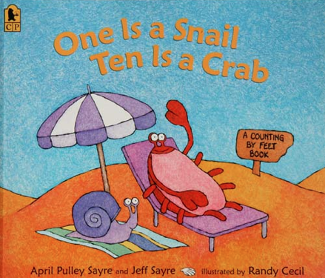
One is a Snail, Ten is a Crab
Core Standard Connections:
Addition--1.OA.A.1; 1.OA.A.2; 2.OA.A.1
Multiplication—3.OA.A.1; 3.OA.A.3
Place Value: 1.NBT.B.2b; 2.NBT.B.9
Skip Counting: 1.NBT.B.2c; 2.NBT.A.2
Standards for Mathematical Practice:
Model with mathematics.
Reason abstractly and quantitatively.
Look for and express regularity in repeated reasoning.
Author: April Sayre
Amazon Price $6.99
Notes:
DOne

Slide 6
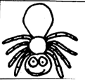
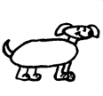
One is a Snail, Ten is a Crab
Addition/Multiplication
Roll a double die—outside is tens value, inside is ones value
Create number sentences for rolled total with a combination of creatures.
Connecting to Place Value
Look at the cover. How does it represent 11?
11=1 crab + 1 snail
11= 1 ten + 1 one
11= 10 + 1
What if the illustrator only drew crabs and snails? How would he show 15?
8 + 8 + 4 = 20
Notes:
READY
15= 1 crab and 5 snails; 15 = 1 ten + 5 ones; 15=10 +5
Repeat with other numbers like 23 & 57. Lesson plan with other ideas on my website.

Slide 7
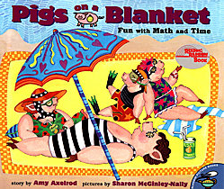
Pigs on a Blanket
Amazon: $6.29
Author: Amy Axelrod
Core Standard Connections:
3.MD.A.1—Time Intervals
2.MD.C.8 or 5.NBT.B.7—Adding Money
3.OA.A.3—Combinations
3.NBT.A. 1; 4.NBT.3.A--Rounding
Standards for Mathematical Practice:
Make sense of problems and persevere in solving them.
Reason abstractly and quantitatively.
Model with mathematics.

Slide 8
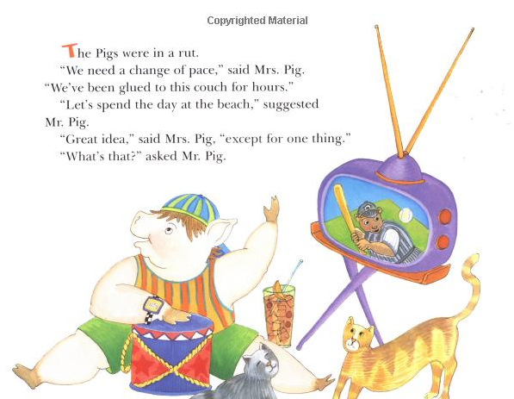

Slide 9
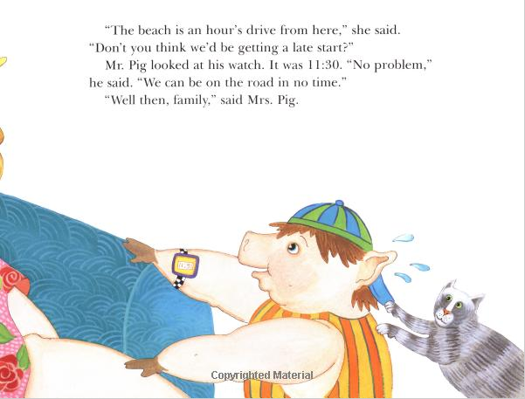

Slide 11
Pigs on a Blanket
Elapsed Time:
Using Plastic Clocks
Using Clock Faces Sheet
Menu Options
Create combinations from food options
Create own menu and design three meals and calculate the costs of those meals
Could extend to practice rounding skills
Notes:
Ready

Slide 12
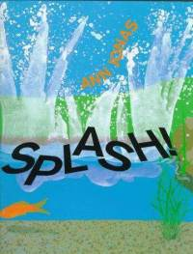
Splash!
Core Standard Connections:
1.OA.A.1—Addition/Subtraction
1.OA.A.2--Multiple Addends
3.OA.A.1--Multiplication
Standards for Mathematical Practice:
Model with mathematics.
Attend to precision.
Author: Ann Jonas
Amazon: $6.29
Notes:
READY

Slide 13
Splash!
Act It Out
Reenact Story
Write Number Sentences in Journal/Whiteboard
Write Own Scenario and exchange
Calculate the number of legs in the pond
Gone Splashing!
Equipment: blue construction paper, colored counters, 2+ dice
Set up and Play:
In pairs, partners roll the dice, model the addition, and record their number sentence. Repeat.
Notes:
Read story—act out in the pond—need blue bulletin board paper for the pond
Blue construction paper cut in half for their own pond
Paper to record addition sentences
4 green (3 frogs and turtle), 2 black (catfish), 4 orange (goldfish), 3 brown (dog, dragonfly, cat), 1 blue (child), 1 red (bird)—unifix cubes
Variations: use a dice to determine if going to be adding or subtracting; create a sheet to record sentences on

Slide 14
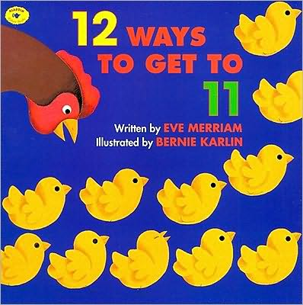
12 Ways to Get to 11
Author: Eve Merriam
Amazon: $7.19
Core Standard Connections:
Addition: 1.OA.A.1; 1.OA.C.6; 2.OA.A.1; 2.OA.B.2;
Standards for Mathematical Practice:
Look for and make use of structure.
Look for and express regularity in repeated reasoning.
Notes:
READY

Slide 15
12 Ways to Get to 11
Rubber Ducks
Find all the Ways
Class Book with Library Pockets
Shel Silverstein Poem—Band-Aids
Things to do with rubber duckies
http://www.karolyeatts.com/Presentations/Quack%20and%20Count%20Math%20Activities.pdf
Notes:
NEED CLASS LIBRARY BOOK SAMPLE PAGE WITH POCKET
Put students in partners
Give each set a number to find all the ways
Record # and # of ways
Have students identify the patterns
Have students predict how many ways to get to 15? 20? 100?
Upper grades—give larger numbers, but demonstrate ‘shortcuts’ to figure out
Debrief with recap of strategies used
Journal—For the number ____, there are ___ ways to add two numbers to get _____. The ways are: _________
Shel Silverstein—Poem Band-Aids—Give each pair two lines from the poem—have them solve the amount by writing a number sentence and drawing an illustration
Create class book of the way to get to ___--Develop (as a class) enough number sentences for each pair to illustrate a page. Have students write the number story in words and then put the actual number sentence inside the library pocket so students can check to see if they are right.

Slide 16
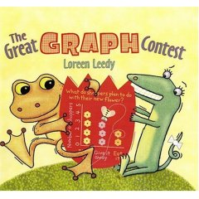
The Great Graph Contest
Author: Loreen Leedy
Amazon: $7.19
Core Standard Connections:
Data: 1.MD.C.4; 2.MD.D.10; 3.MD.B.3
Standards for Mathematical Practice:
Make sense of problems and persevere in solving them.
Model with mathematics.
Use appropriate tools strategically.
Notes:
READY

Slide 17
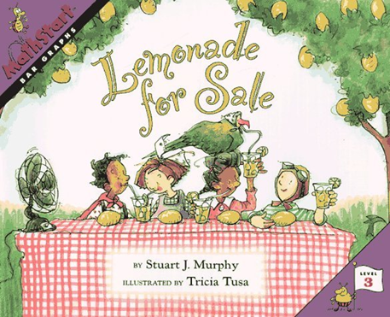
The Great Graph Contest and Lemonade For Sale
Different Types of Graphs (yes/no, links, floor mat, Venn diagram, etc.)
Partner Survey and graph
If you could be an animal, what type would you be?
Reptile, Mammal, Bird, Imaginary
How many pets do you have?
What is your favorite sport?
Great for food--Fruit snacks, colored goldfish, animal cookies, skittles, M&Ms, etc.
Notes:
READY
Model different types of graphs
Yes/No Graph
Little Girls/Boys Diecuts
Links Graph
Floor Mat Graph—Diecuts
Venn Diagram
In partners, come up with a question and survey class. Create a graph that represents the data. Have different templates ready.

Slide 18
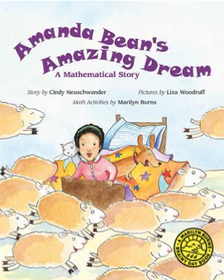
Amanda Bean’s Amazing Dream
Author: Cindy Neuschwander
Amazon: $13.21
Core Standard Connections:
Arrays: 2.OA.C.4; 3.OA.A.3; 4.NBT.B.6
Multiplication: 3.OA.A.1; 4.OA.A.1;
Distributive Property: 3.OA.B.5
Standards for Mathematical Practice:
Model with mathematics.
Attend to precision.
Notes:
DONE

Slide 19
Amanda Bean’s Amazing Dream
Array a Day
Write 10 things about the array (perimeter, area, fraction of each color square, multiplication equation, etc.)
Marshmallow Arrays on Graph Paper
How Many? How Long?
Use one die labeled with 0, 1, 2,
Use one die labeled with 2-7
Partners work to fill their board as much as
possible; the game board with less uncovered
spaces wins
5 x 2 =10
Notes:
Ready

Slide 20
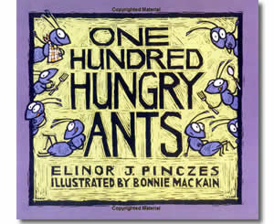
One Hundred Hungry Ants
Author: Elinor J. Pinczes
Amazon: $6.29
Core Standard Connections:
2.G.A.2—partitioning
3.OA.A.1; 3.0A.A.3--multiplication
4.NBT.B.6—relationship between multiplication and division
4.NBT.A.1—place value and multiplication
Standards for Mathematical Practice:
Model with mathematics
Make sense of problems and persevere in solving them

Slide 21
One Hundred Hungry Ants Ants
100 Plastic Ants
100 cubes—make the arrangements
Extend it by giving them a choice of numbers—12, 24, 48
Draw it out
Class Book “60 Starving Salamanders” or other title
Students create one of the arrangements
Record the equation
Write the text
Investigating 100 Ants
Notes:
Do the connection for division for this one,too.
100 Plastic Ants—reenact the story in small groups

Slide 22
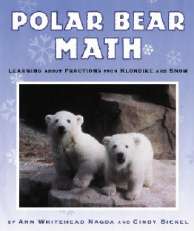
Polar Bear Math
Author: Ann Nagda
Amazon: $7.58
Core Standard Connections:
Standards for Mathematical Practice:

Slide 23
Polar Bear Math

Slide 24
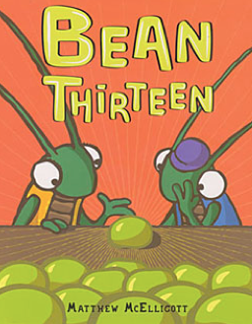
Bean Thirteen
Author: Matthew McElligott
Amazon: $11.93
Core Standard Connections:
3.OA.A.2; 4.OA.A.2—Division
4.OA.B.4—Prime/Composite Numbers
2.OA.C.3—Odd/Even
Standards for Mathematical Practice:
Look for and express regularity in repeated reasoning.
Make sense of problems and persevere in solving them.

Slide 25
Bean Thirteen
1st Read: Model the story with beans, counters, magnets, etc.
Include number sentence
Include table noting odd/even (look for patterns)
Connect to prime/composite
Have them practice the story—15 or 18 beans and bug buddies
Author’s Website:http://matthewmcelligott.com/beanthirteen/projects.php

Slide 26
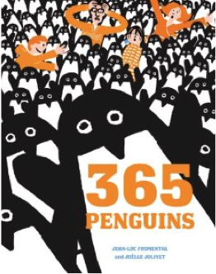
365 Penguins
Core Standard Connections:
3.NBT.A.2—Multi-digit addition
4.NBT.B.5—Multi-digit multiplication
4.OA.C.5—Shape Patterns
Standards for Mathematical Practice:
Make sense of problems and persevere in solving them.
Attend to precision.
Look for and make use of structure.
Author: Jean-Luc Fromental
Amazon: $14.33
Notes:
Ready

Slide 27
365 Penguins
Penguin Delivery Math Task
Penguin Formation Task
When 60 penguins had arrived Dad arranged them in 4 sets of 15. When happens when penguin number 61 arrives?
Can 61 penguins make a perfect triangle formation?
If not how many more penguins must Dad have before he can create a triangle?
Penguin Birthday Problem
Notes:
Ready

Slide 28
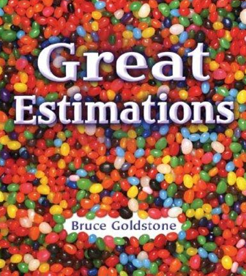
Great Estimations
Author: Bruce Goldstone
Amazon: $6.29
Core Standard Connections:
Standards for Mathematical Practice:

Slide 29
Great Estimations

Slide 30
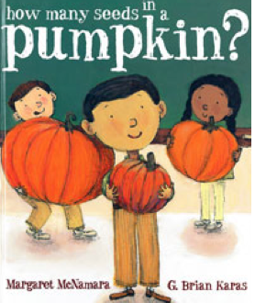
How Many Seeds in a Pumpkin?
Author: Margaret McNamara
Amazon: $12.45
Core Standard Connections:
Estimation
Skip Counting: 1.NBT.B.2c; 2.NBT.A.2
Multiplication by 2s, 10s and 5s—3.OA.A.3; 3.OA.A.1; 3.NBT.A.3
Standards for Mathematical Practice:
Make sense of problems and persevere in solving them.
Construct viable arguments and critique the reasoning of others.
Notes:
Done—available at Barnes and Noble right now

Slide 31
How Many Seeds in a Pumpkin?
Pumpkin Seed Estimation
How Would You Count the Seeds?
How many seeds in each pumpkin? (great math task—let kids solve in any way they can
repeated addition, multiplication, mental math, etc.
Scientific Work—Using the pumpkin facts, test it out and see if it holds true
Chart the number of ribs, color and number of seeds
Notes:
Done
For each line on the outside there is a row of seeds on the inside
The longer a pumpkin grows the more lines on it and the darker the skin

Slide 32
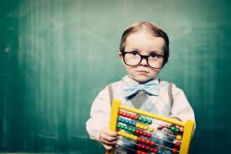
Selecting Quality Math Literature
Three Categories:
General Criteria
Engaging
Appealing
Numeracy Criteria
Rich mathematical context
Real-life application
Literacy Criteria
Great story
Enjoyable enough to reread
Notes:
Done

Slide 33
Contact Information
Jennifer Throndsen
Evidence-Based Learning in Canyons School District
Jennifer.throndsen@canyonsdistrict.org
Website: http://amazingachievement.weebly.com
Notes:
Done

