Slide 1
Word Walls
“Having” a word wall is not enough, we have to “do” the word wall

Slide 2
Why Word Walls?
100 words account for almost half of all the words we read and write
Ten words—of, the, and, a, to, in is, you, that, it—account for almost a quarter of all the words we read and write
Frees them for decoding and improves spelling
Struggling readers have great difficulty learning these words

Slide 3
Doing a Word Wall
1. Add words gradually—five or so a week
2. Make them accessible—where everyone can see them
Consider using a variety of colors so that constantly confused ones have a color cue (for, from; that, them, they, this, etc.)
3. Practice the words by chanting and writing them
Struggling readers are not usually good visual learners and can’t just look at and remember the words
4. Do a variety of review activities
5. Make sure word wall words are spelled correctly in any writing students do (hold them accountable)

Slide 4
Word Wall Instruction
Teacher introduces word (use it in a sentence to give it some context)
Show them the word
Have them say the word
Chant the words (snap, clap, stomp, cheer)
Write the words and check them together with the teacher

Slide 5
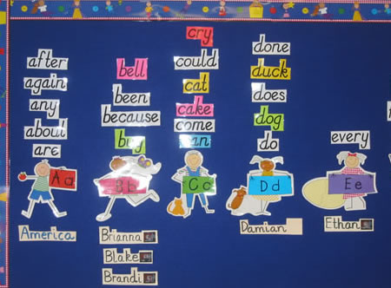
Notes:
1. It’s a word on the word wall. It has four letter. It begins with “d”. It rhymes with stuck. It finishes the sentence “In the pond, I saw a white ______.”

Slide 6
Clap It—Slap It—Snap It—Write It
“Ready”—pencils are down
“Clap it ”d..u..c..k ….duck”

Slide 7
Pump It Up
Pretend like they are lifting weights
The first time we chant the letters and the word the weights are really heavy, so we go really slow
Each time we repeat we get faster/stronger and the weights get easier
The last time is super fast

Slide 8
Magic Wands
Students take their pencil and pretend it is a magic wand
They practice chanting the letters of the word and writing the word in the air with their “magic wand”

Slide 9
Sing the Word
3 letter words
http://mrsjonesroom.com/songs/3letter.html
Mary Had a Little Lamb
4 letter words
http://mrsjonesroom.com/songs/4letter.html
Oh, my darling
5 letter words
http://mrsjonesroom.com/songs/5letter.html
BINGO

Slide 10
Be a Mind Reader
On the back of their word wall practice paper:
Number their paper from 1-5
See if you can read my mind
Give five clues
First clue is always: “It’s one of the words on the word wall.”
Last clue usually “It completes this sentence…”
Let’s try it…

Slide 11
Independent Station Ideas

Slide 12
Rainbow Writing
Materials: 3 x 5 cards, 5 colors of crayons
1) Pick a word wall word to copy and five crayons (could just choose from your concept board list of high frequency words)
2) Write the word in one color, and whisper the letters as you write them.
3) Repeat over the top of each letter in four other colors.
Note: need to write the whole word each time—not one letter at a time

Slide 13
Mix-it, Fix-it
Materials: word wall word cards, magnetic letters
1) Pick a word wall word card.
2)Make the word with magnetic letters.
3) Mix up the letters.
4)Fix the word by putting the letters back in order.
5) Write the word in word wall book—or other notebook
6) Repeat with new word.

Slide 14
Read the Wall
Students work in partners and quiz each other on the word wall words
Could have them write down five-eight words that they read

Slide 15
Whole Class Review Games

Slide 16
Pass the Pooh
Using a stuffed animal, you pass the Pooh to one of the students and point to one of the word wall words for them to read, then class choral reads the same word
They read the word and pass the Pooh to someone else and repeat

Slide 17
Around the World
2 students stand up—side by side
Teacher points to one of the word wall words
The student to read the word first moves on to the next student
Goal—is the get all the way around the class

Slide 18
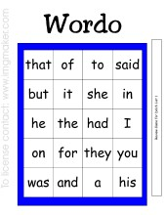
WORDO

Slide 19
Use the foam finger/pointer
Student uses the teacher’s pointer or foam finger and points to a word on the wall
The class reads the words
Variation
Flashlight Fun
Turn out the lights.
Say the poem together with the class: Flashlight, flashlight, oh so bright, Shine on a word with your light.
Shine the flashlight on individual words for the class to read and chant.

Slide 20
Other Activities
Rhyme with the word wall
Find a word that rhymes with door—for
Reviewing endings
Pick an ending –s, -es, -ing
Word Categories
• Find words that have certain qualities in common.
Students write them down along with the teacher.
Examples:
Words that begin with vowels
Words of a certain length
Words that describe
Words that end with a suffix
Words that begin with certain onsets and rimes

